Slide 1
Project Experience
Topic: Naïve Bayesian Model under Local Differential Privacy
Background and Objective
Classification algorithms such as Naive Bayesian model learn from fresh input data to classify instances correctly.
However, such data usually contain sensitive information, causing serious privacy concerns
The model of local differential privacy(LDP) provides strong privacy guarantees
Our goal is to address the problem of Naive Bayesian classification under LDP to provide privacy protection

Slide 2
Project Experience
Preliminaries
Differential privacy(DP): By perturbing data, it assures that removing or adding a single database element has no significant impact on the querying results
Local differential privacy(LDP): Applying DP to local setting and allowing the individuals to perturb their data locally by a specific randomized mechanism or function.
Main idea: to minimize the possibility of identifying individual records while retaining statistical features to protect user privacy

Slide 3

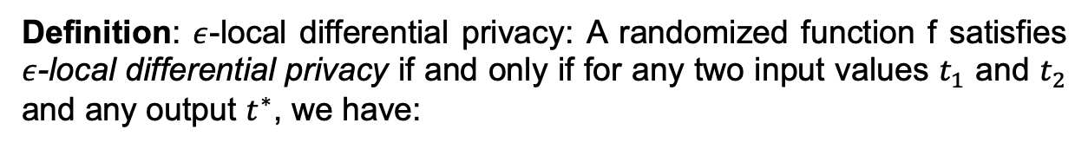
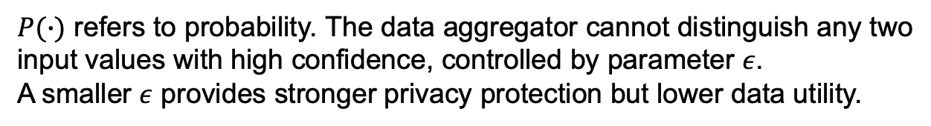
Project Experience
Definition: $ε$-local differential privacy: A randomized function f satisfies $ε$-local differential privacy if and only if for any two input values $t_{1}$ and $t_{2}$ and any output $t^{∗}$, we have:
$P(∙)$ refers to probability. The data aggregator cannot distinguish any two input values with high confidence, controlled by parameter $ε$.
A smaller $ε$ provides stronger privacy protection but lower data utility.
Main idea: to minimize the possibility of identifying individual records while retaining statistical features to protect user privacy

Slide 4
Project Experience
Two major tasks under LDP:
Frequency estimation: one needs to find how many times each value appears in the perturbed dataset(for discrete data).
Mean estimation: one needs to estimate the mean value over perturbed continuous values.
Perturbed data is the unbiased estimation of original data.

Slide 5
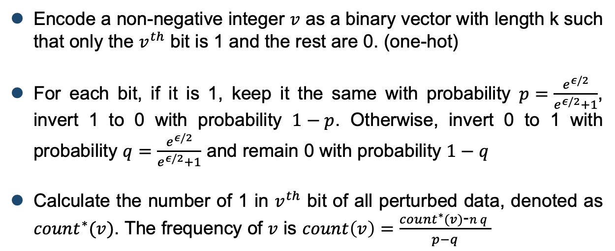
Project Experience
Frequency Estimation under LDP—Symmetric Unary Encoding(SUE)
Proposed by Wang et al.
Encode a non-negative integer $v$ as a binary vector with length k such that only the $v^{th}$ bit is 1 and the rest are 0. (one-hot)
For each bit, if it is 1, keep it the same with probability $p=\frac{e^{ε/2}}{e^{ε/2}+1}$, invert 1 to 0 with probability $1−p$. Otherwise, invert 0 to 1 with probability $q=\frac{e^{ε/2}}{e^{ε/2}+1}$ and remain 0 with probability $1−q$
Calculate the number of 1 in $v^{th}$ bit of all perturbed data, denoted as ${count}^{∗}(v)$. The frequency of $v$ is $count\left(v\right)=\frac{{count}^{∗}(v)\text{−}nq}{p−q}$

Slide 6
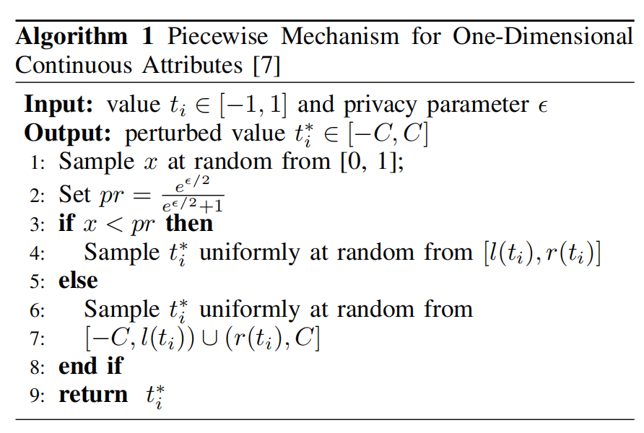
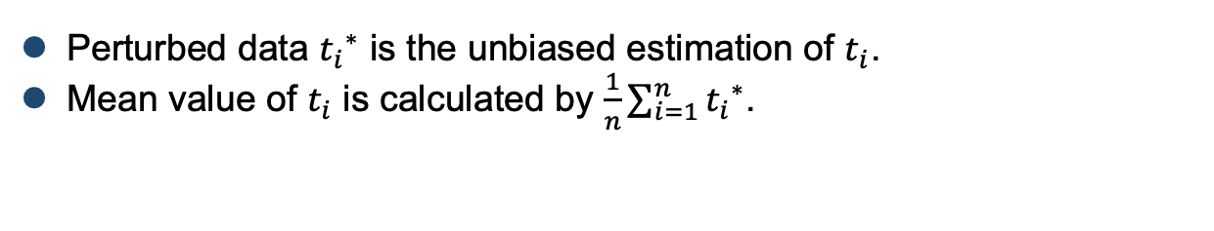
Project Experience
Mean Estimation under LDP—Piecewise Mechanism(PM)
Proposed by N. Wang et al
Perturbed data ${t_{i}}^{∗}$ is the unbiased estimation of $t_{i}$.
Mean value of $t_{i}$ is calculated by $\frac{1}{n}\sum_{i=1}^{n}{{t_{i}}^{∗}}$.

Slide 7

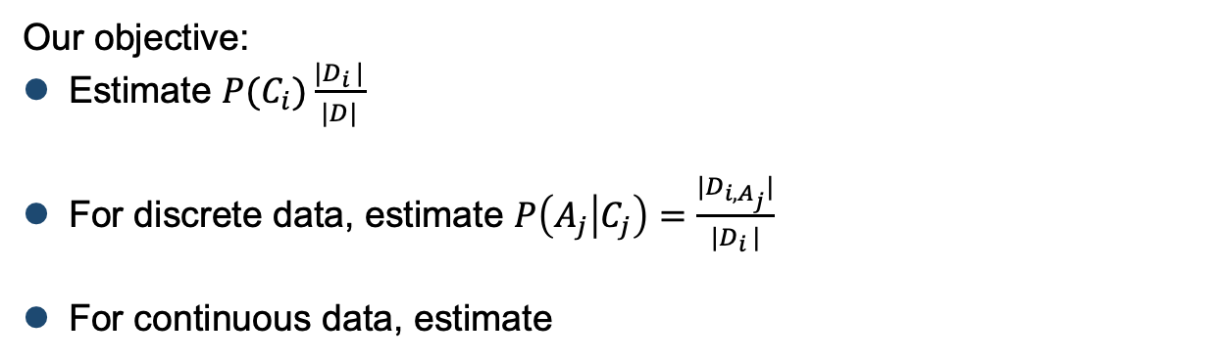
Project Experience
Naïve Bayesian Model:
$$P\left(C_{i} | X\right)=\frac{P(C_{i})P(X|C_{i})}{P(X)}=\frac{P(C_{i})\prod_{j=1}^{d}{P(A_{j}|C_{j})}}{P(X)}$$
Our objective:
Estimate $P(C_{i})\frac{|D_{i }|}{|D|}$
For discrete data, estimate $P\left(A_{j} | C_{j}\right)=\frac{|D_{i,A_{j}}|}{{|D}_{i }|}$
For continuous data, estimate

Slide 8
Project Experience
Our work
For continuous data, we present a computation method to compute mean and variance for each class without accessing true class label based on Gaussian Naïve Bayesian Model, using PM method.
For discrete data, we present estimation method to estimate conditional probabilities and prior probabilities for each class, using SUE method

Slide 9
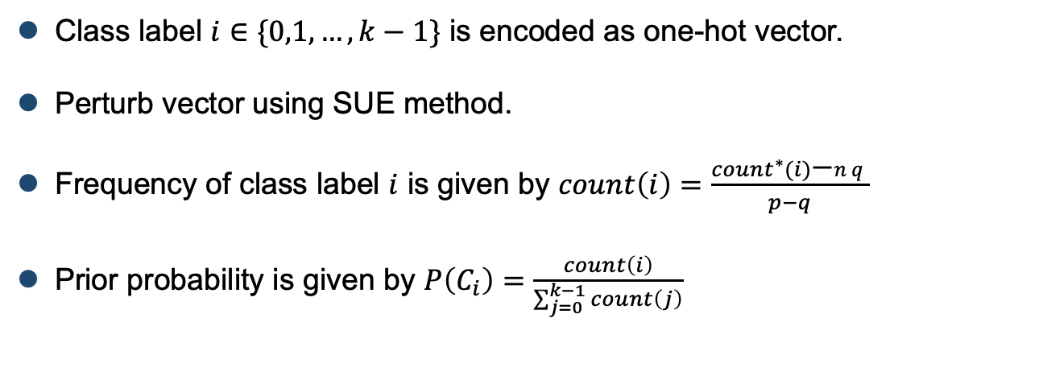
Project Experience
Computation of prior probabilities for each class
Class label $i∈\{0,1,…,k−1\}$ is encoded as one-hot vector.
Perturb vector using SUE method.
Frequency of class label $i$ is given by $count\left(i\right)=\frac{{count}^{∗}(i)\text{−}nq}{p−q}$
Prior probability is given by $P\left(C_{i}\right)=\frac{count\left(i\right)}{\sum_{j=0}^{k−1}{count\left(j\right)}}$

Slide 10
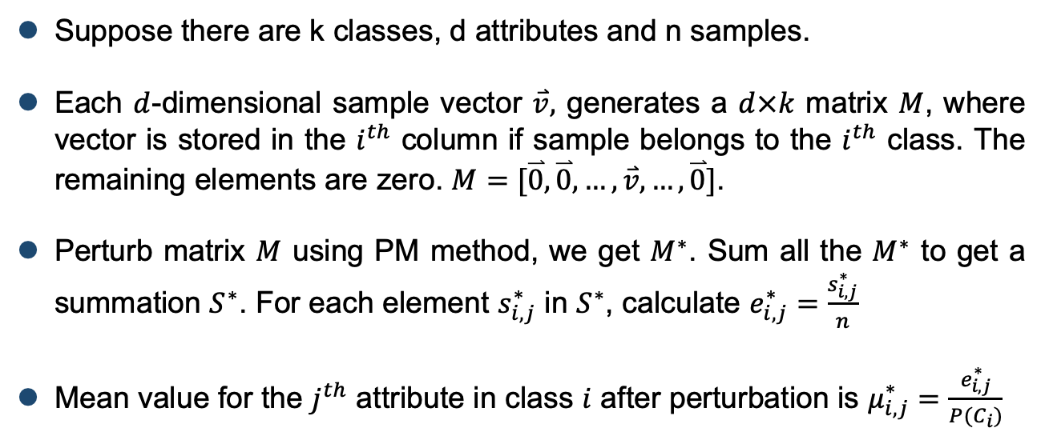
Project Experience
Computation of mean for continuous data
Suppose there are k classes, d attributes and n samples.
Each $d$-dimensional sample vector $\overset{⃑}{v},$ generates a $d×k$ matrix $M$, where vector is stored in the $i^{th}$ column if sample belongs to the $i^{th}$ class. The remaining elements are zero. $M=[\overset{⃑}{0},\overset{⃑}{0},…,\overset{⃑}{v},…,\overset{⃑}{0}]$.
Perturb matrix $M$ using PM method, we get $M^{∗}$. Sum all the $M^{∗}$ to get a summation $S^{∗}$. For each element $s_{i,j}^{∗}$ in $S^{∗}$, calculate $e_{i,j}^{∗}=\frac{s_{i,j}^{∗}}{n}$
Mean value for the $j^{th}$ attribute in class $i$ after perturbation is $μ_{i,j}^{∗}=\frac{e_{i,j}^{∗}}{P(C_{i})}$

Slide 11
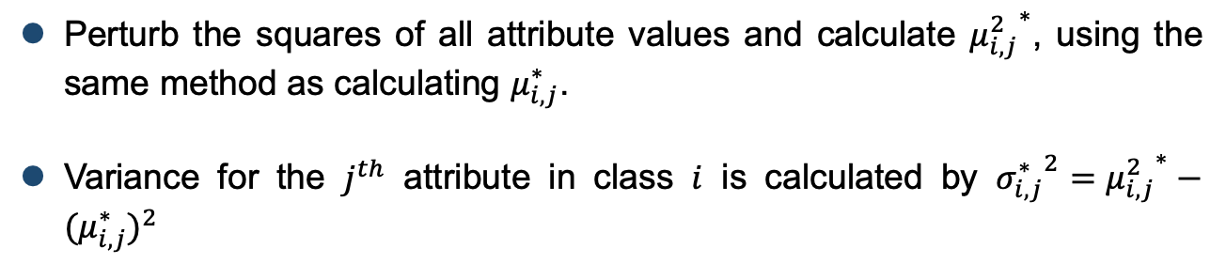
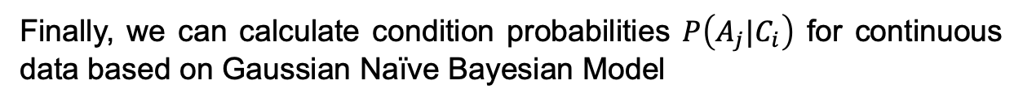
Project Experience
Computation of variance for continuous data
Perturb the squares of all attribute values and calculate ${μ_{i,j}^{2}}^{∗}$, using the same method as calculating $μ_{i,j}^{∗}$.
Variance for the $j^{th}$ attribute in class $i$ is calculated by ${σ_{i,j}^{∗}}^{2}={μ_{i,j}^{2}}^{∗}−{(μ_{i,j}^{∗})}^{2}$
Finally, we can calculate condition probabilities $P\left({A_{j}|C}_{i}\right)$ for continuous data based on Gaussian Naïve Bayesian Model

Slide 12
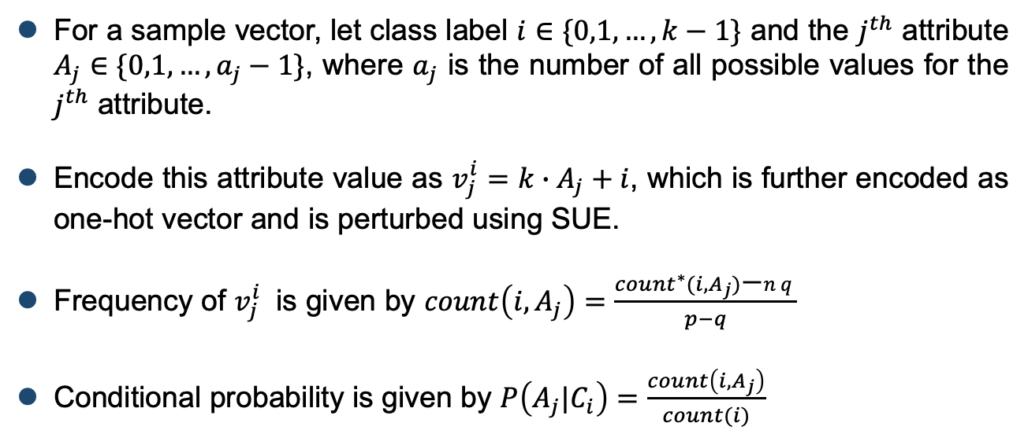
Project Experience
Computation of conditional probabilities for discrete data
For a sample vector, let class label $i∈\{0,1,…,k−1\}$ and the $j^{th}$ attribute $A_{j}∈\{0,1,…,a_{j}−1\}$, where $a_{j}$ is the number of all possible values for the $j^{th}$ attribute.
Encode this attribute value as $v_{j}^{i}=k∙A_{j}+i$, which is further encoded as one-hot vector and is perturbed using SUE.
Frequency of $v_{j}^{i}$ is given by $count\left(i,A_{j}\right)=\frac{{count}^{∗}(i,A_{j})\text{−}nq}{p−q}$
Conditional probability is given by $P\left({A_{j}|C}_{i}\right)=\frac{count\left(i,A_{j}\right)}{count(i)}$

Slide 13
Project Experience
Experimental Results
We implemented the algorithm using Python 3.7
We experiment with the following datasets: the Diabetes, WDBC, Chess, Connect-4 and Mushroom datasets from UCI repository.
For each dataset, 80% of the data are selected for training and 20% of data are selected for testing.
We perform each experiment 100 times and take the mean of accuracy as the results.

Slide 14
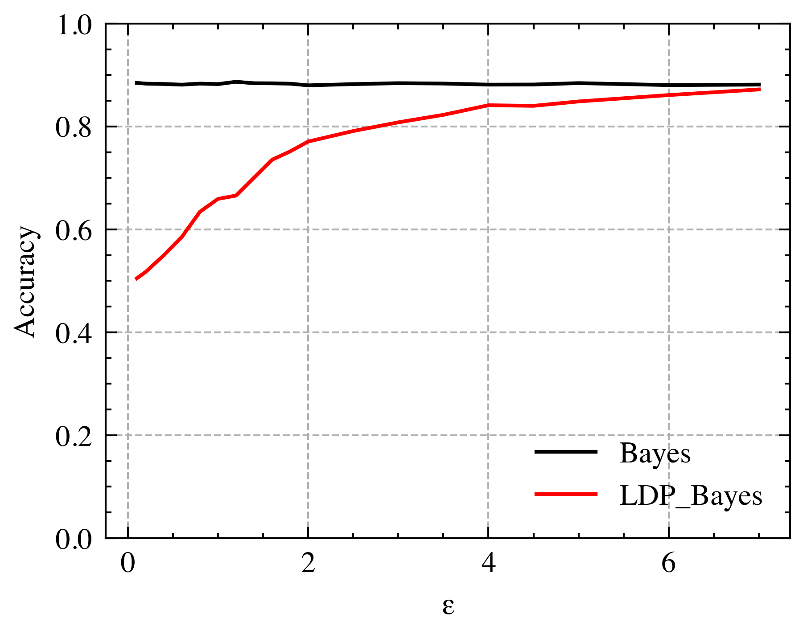
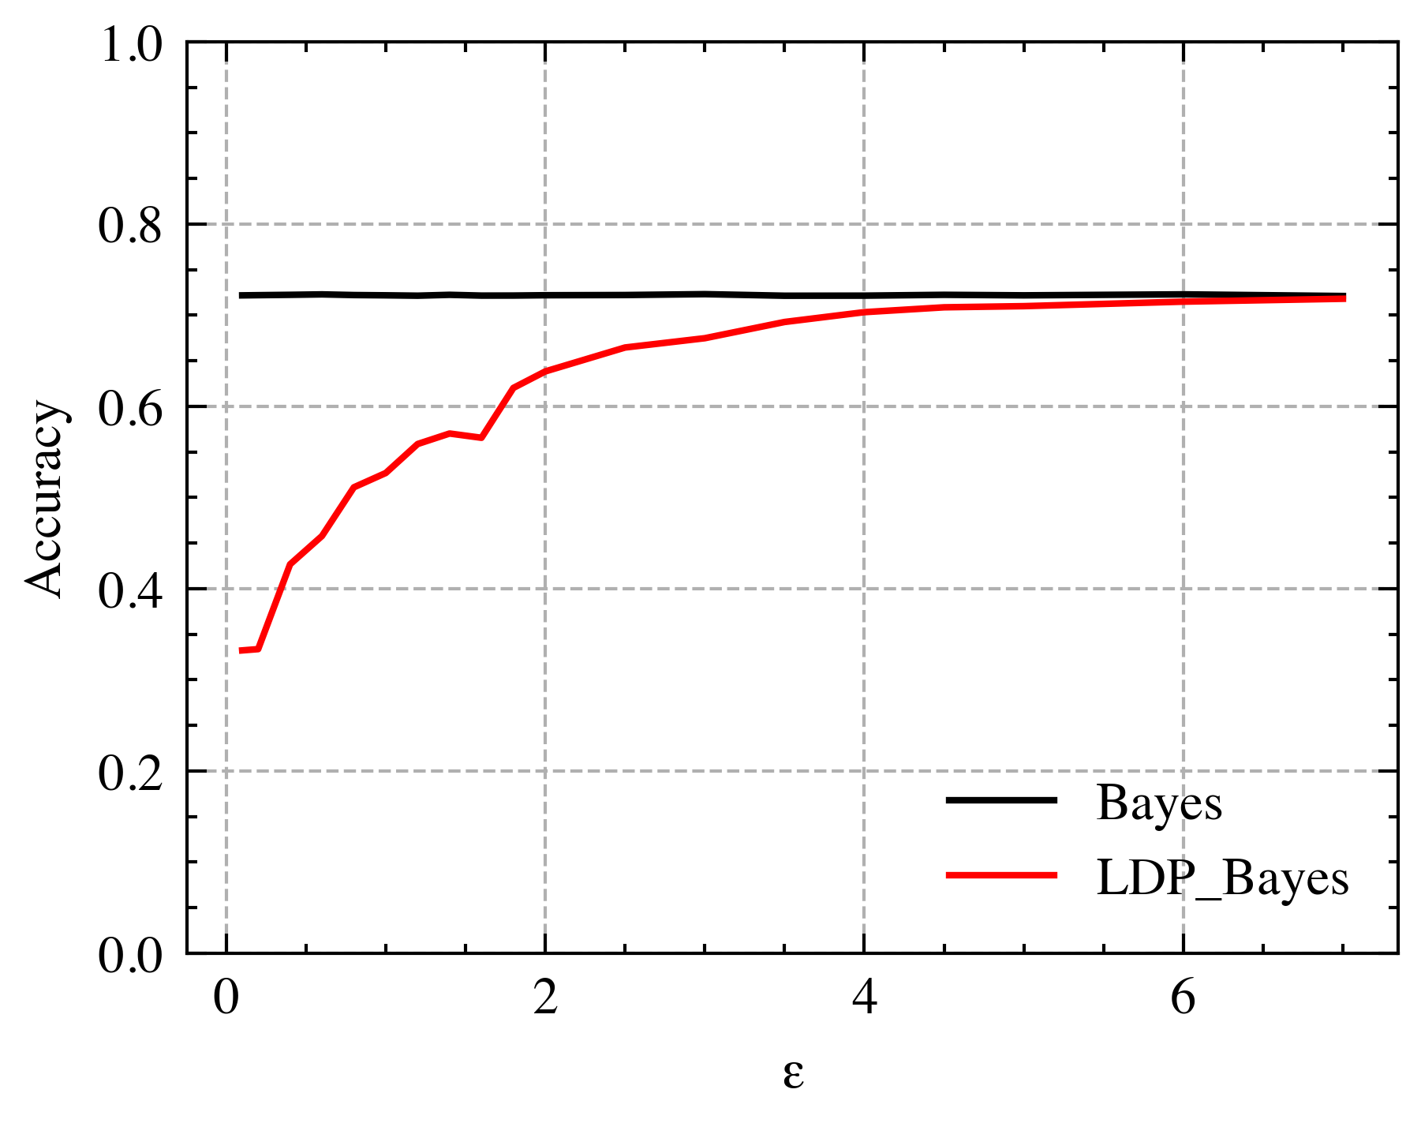
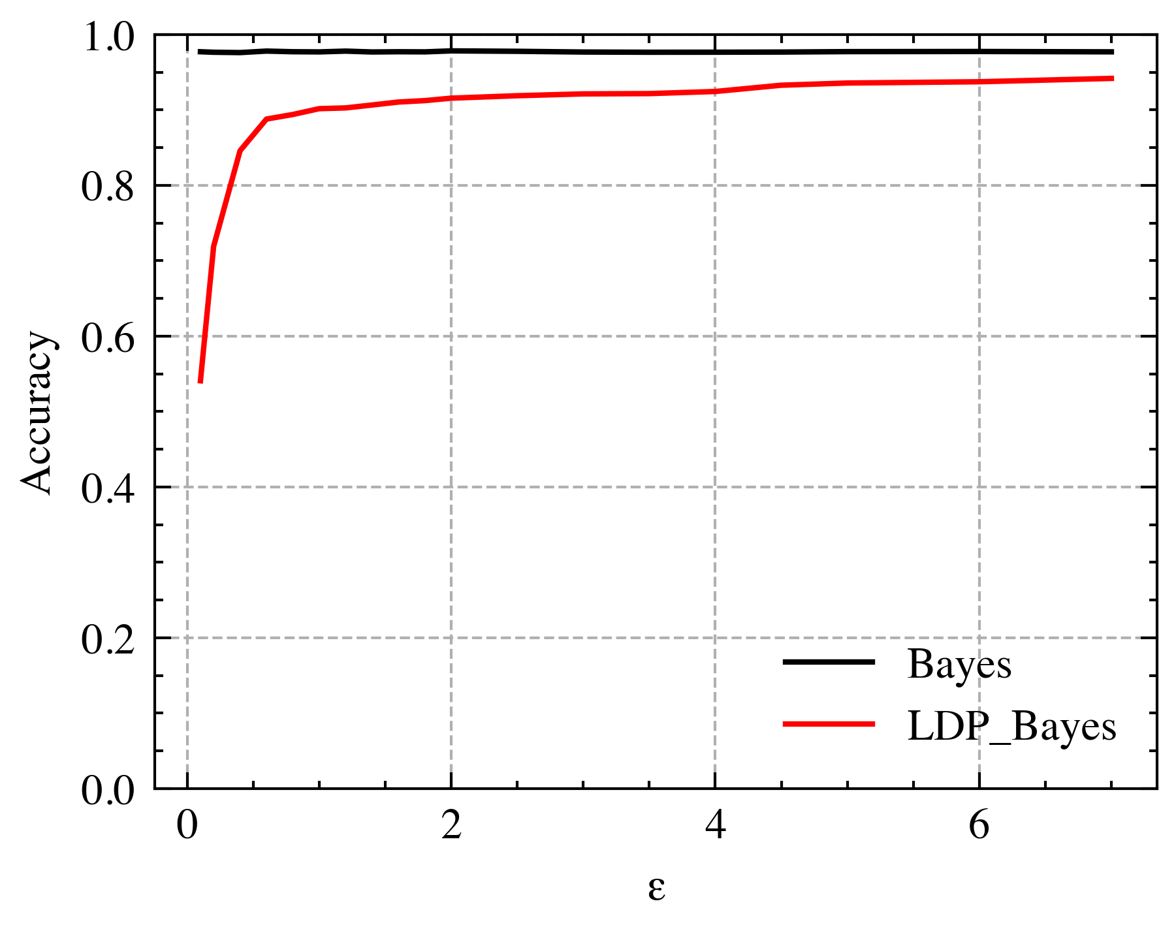
Project Experience
Experimental Results
Chess dataset
Connect-4 dataset
Mushroom dataset
Accuracy for datasets with discrete data

Slide 15
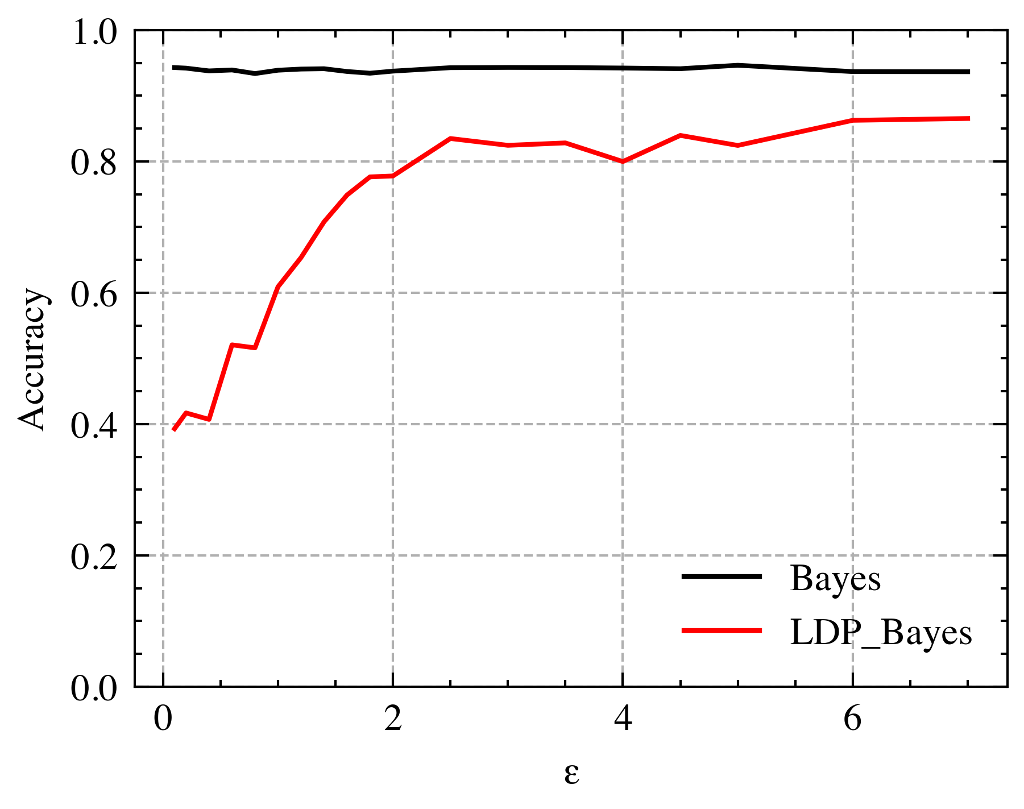
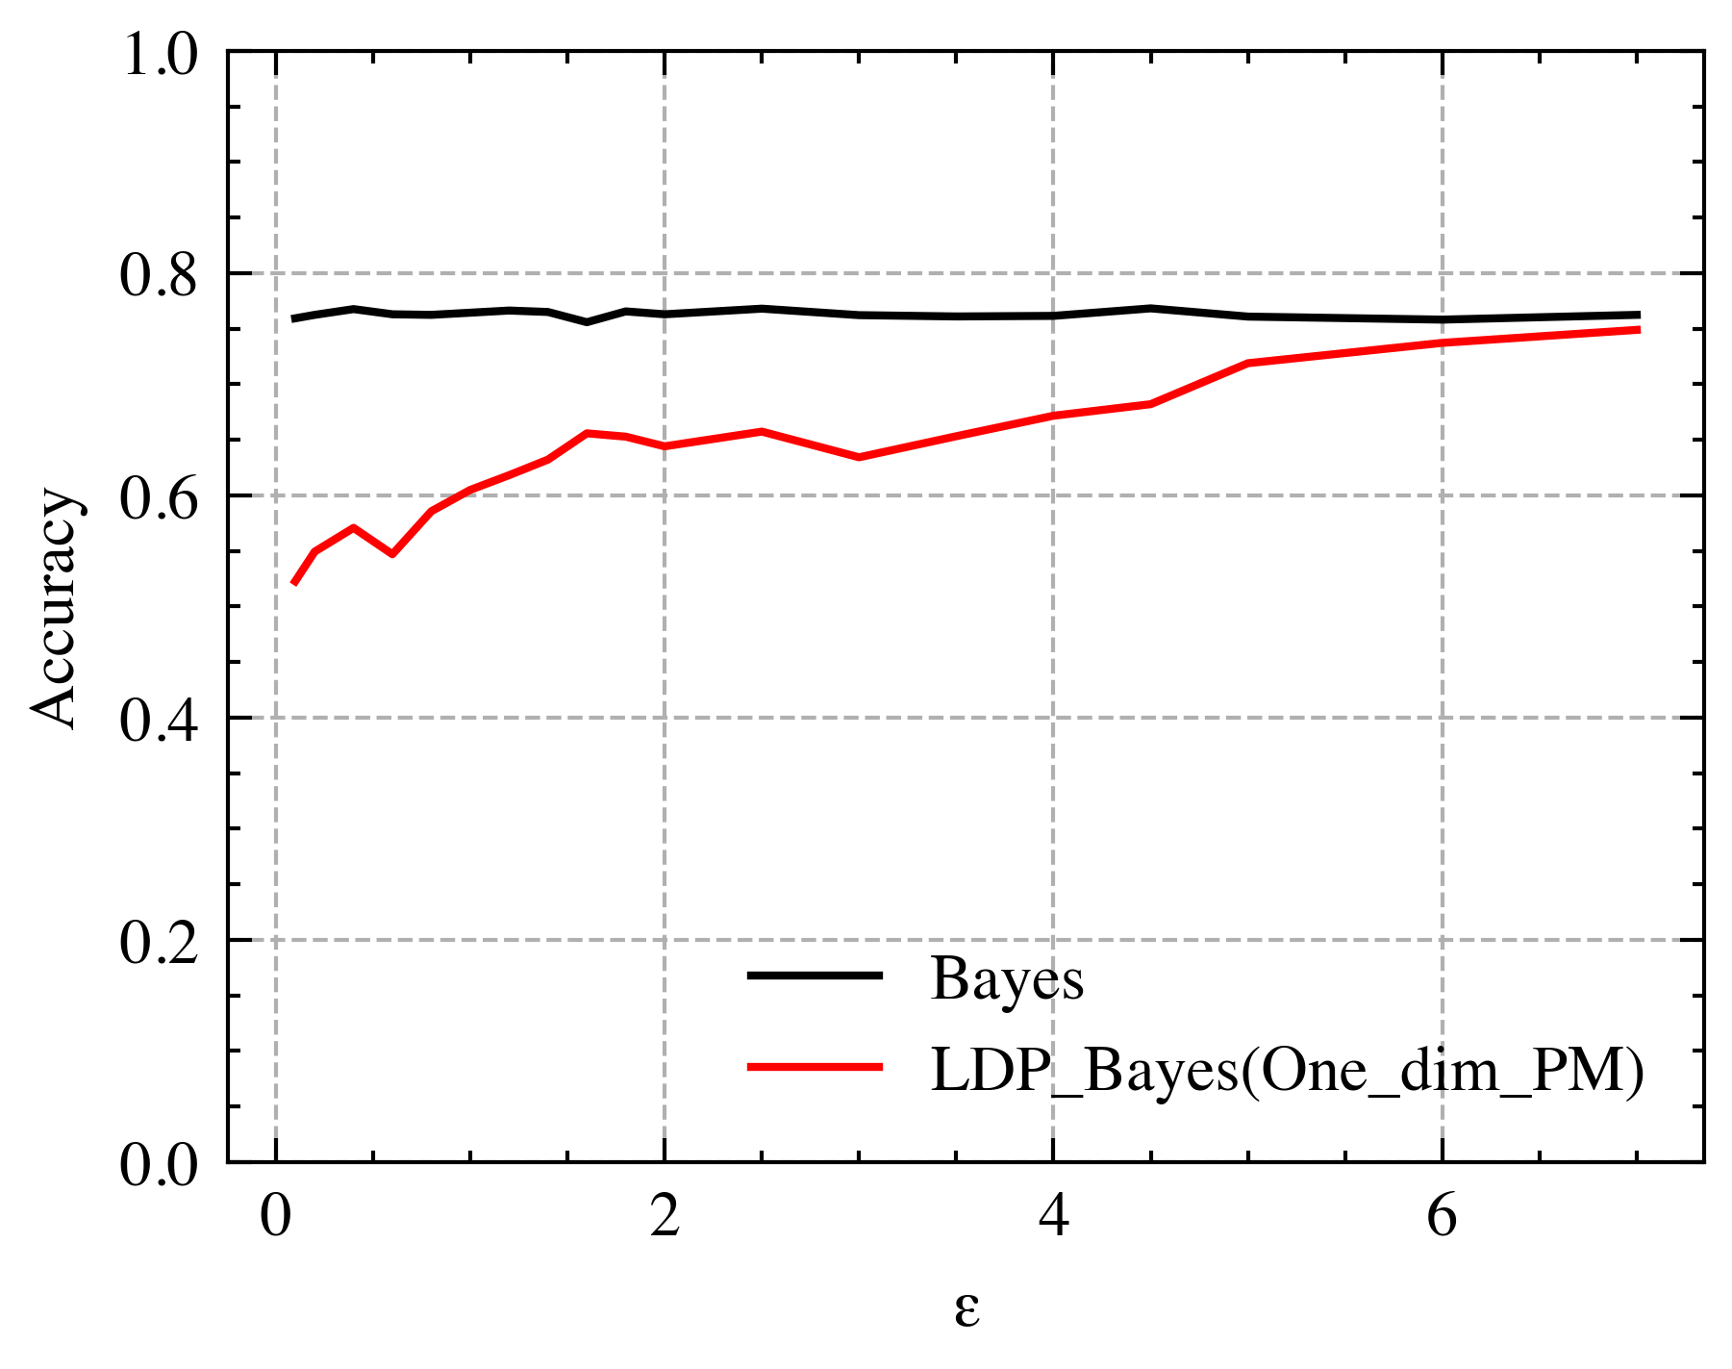
Project Experience
Experimental Results
WDBC dataset
Diabetes dataset
Accuracy for datasets with continuous data

Slide 16

THANKS

